Slide 1
/*{ CODE JUDGE }*/
Developers
Gaurav Rajput
Divyank Pahlazani
Himanshu Nigam

Slide 2
Brief Overview Of the Project
Code Judge is a web portal where online coding examinations can be conducted or the user can enhance the skills by attempting the coding challenges.
For every program there will be certain test cases that the student should pass in order to clear the test. The Leader Board will have names of students in order of their marks and completion time.

Slide 3
Motivation
Whenever coding examinations are conducted, the students are required to write a program and the examiner needs to check the program of each and every student individually.
So, Code Judge will allow the examiner the flexibility to conduct tests, the Code Judge will examine all the submitted codes by students and check all at once whose program has been executed and grade them accordingly, this will save the time and extra work of the examiner.
Many times students copy and paste the programs therefore Code Judge will also provide the functionality for preventing copying and pasting any pre written programming code, this ensures that students write the program with their own knowledge.

Slide 4
Modules
Currently, we are working on the following modules:
Front End Module
Database Module

Slide 5
Front End Module
In this module, we have developed following pages for our application
Code Judge
Home Page
Sign Up / Sign In
Practice Now
About Us

Slide 6
Wireframe Model
Description of the GUI and Layouts

Slide 7
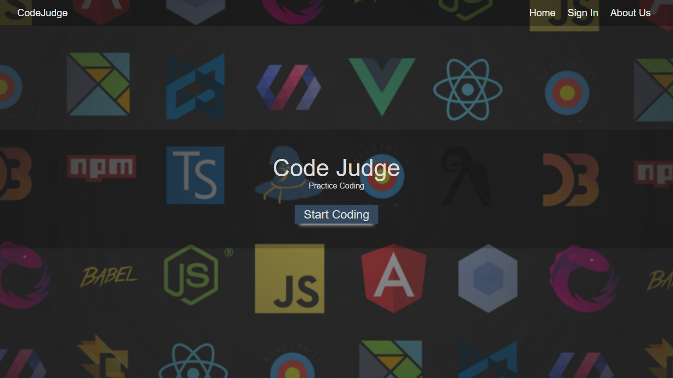
Home Page

Slide 8
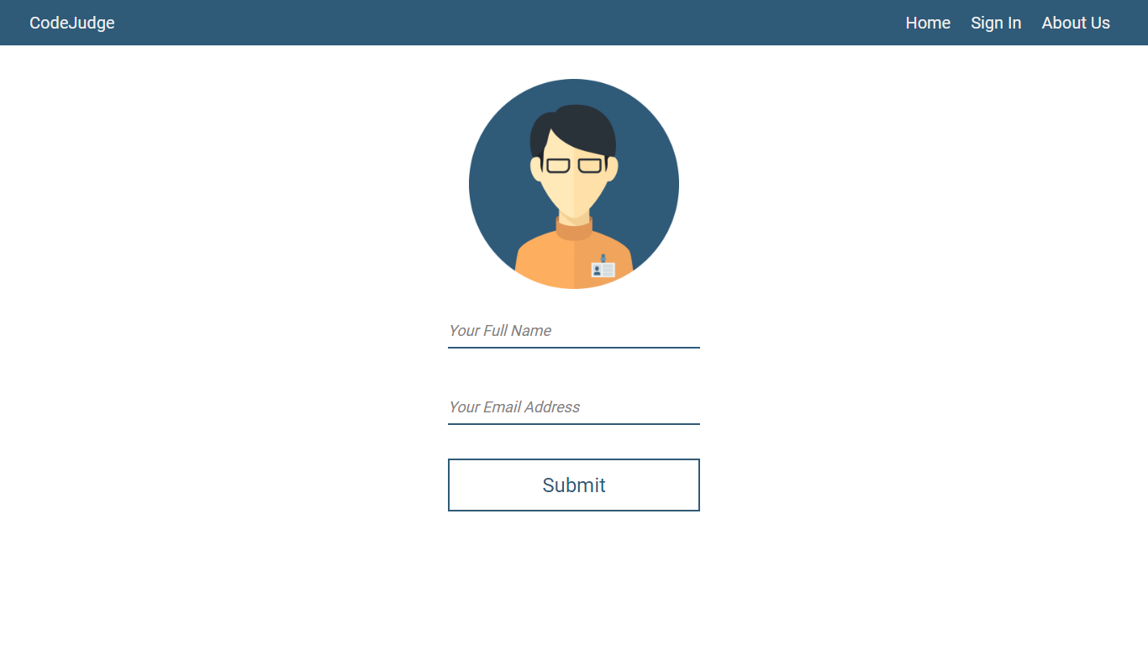
Sign In / Sign Up

Slide 9
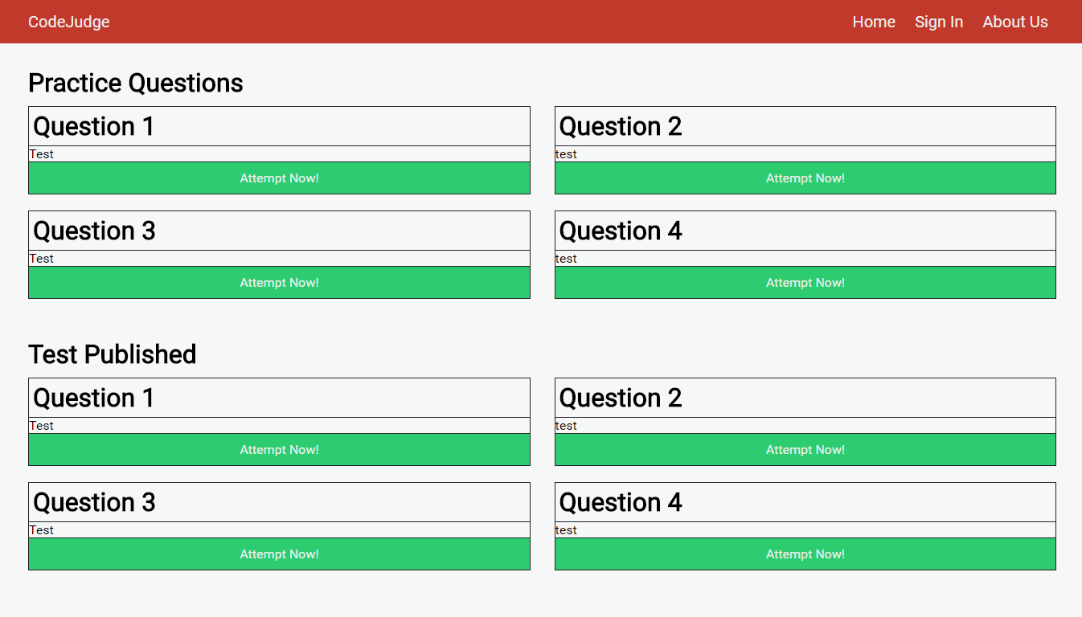
Practice Now

Slide 10
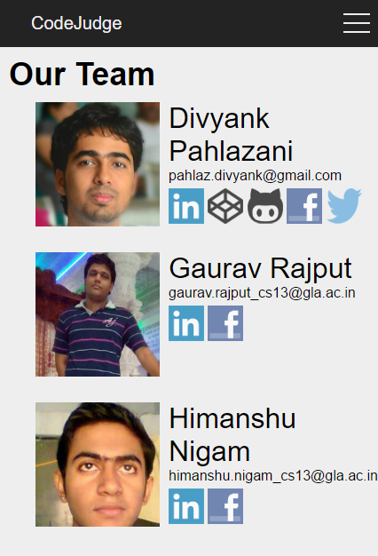
About Us

Slide 11
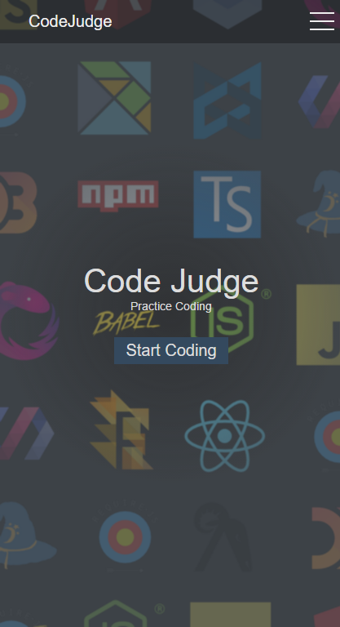
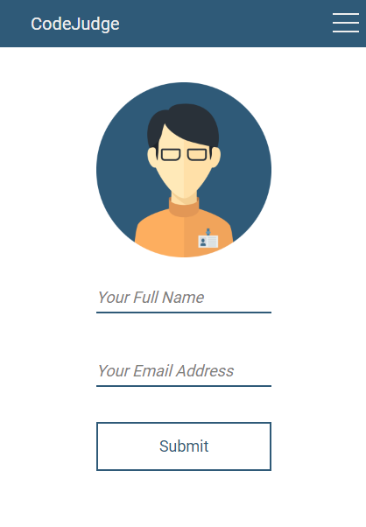
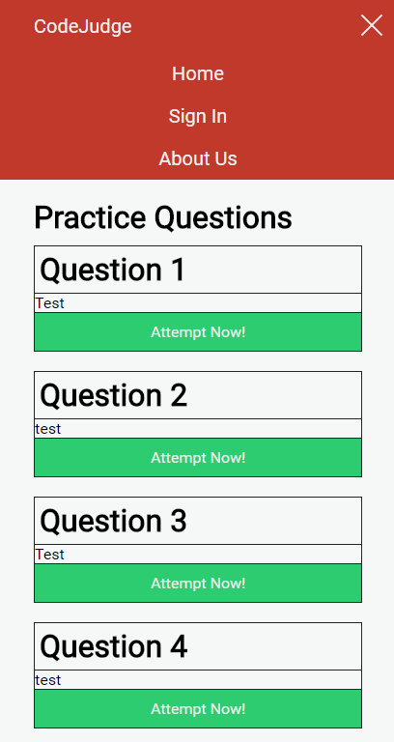
Mobile View

Slide 12
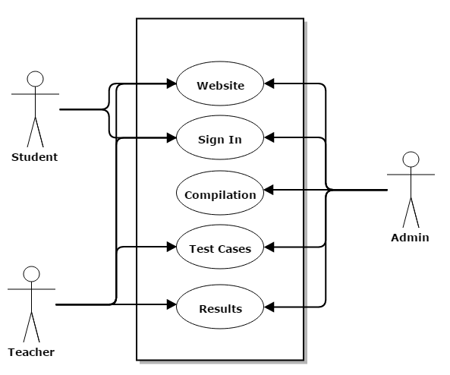
Use Case Diagram

Slide 13
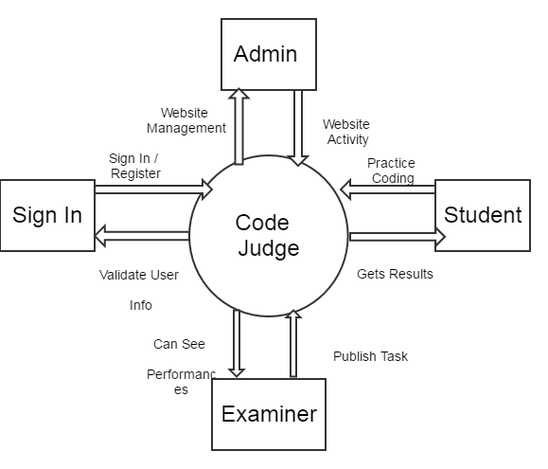
DFD: Level O

Slide 14
Feasibility Study
Since our project is a student based project and we are implementing it at the college level.
There is no such constraint of money as we are having all the required basic resources.
If we talk about the time constraint, as we have to complete this project till next semester’s end so after looking at our current proceedings it seems that we are having good pace and will be able to complete it much before the presumed deadline.
As far as the technical feasibility is concerned, we are open to all server side technologies and we can switch to the one which is most appropriate and convenient for a particular module and the project.

Slide 15
Database Modules

Slide 16
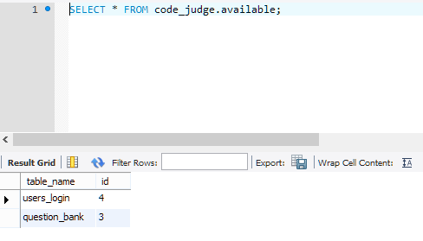
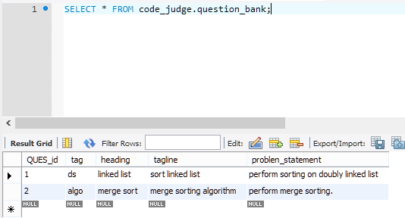
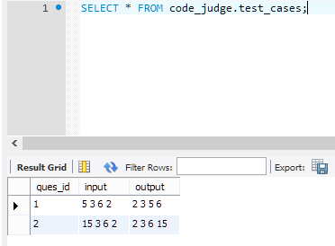
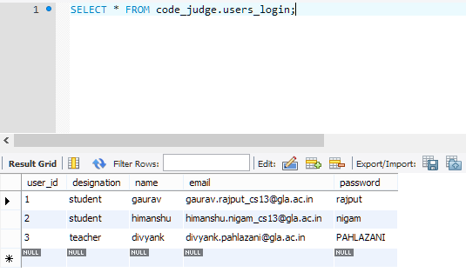

Slide 17
.
Functioning of Test Cases

Slide 18
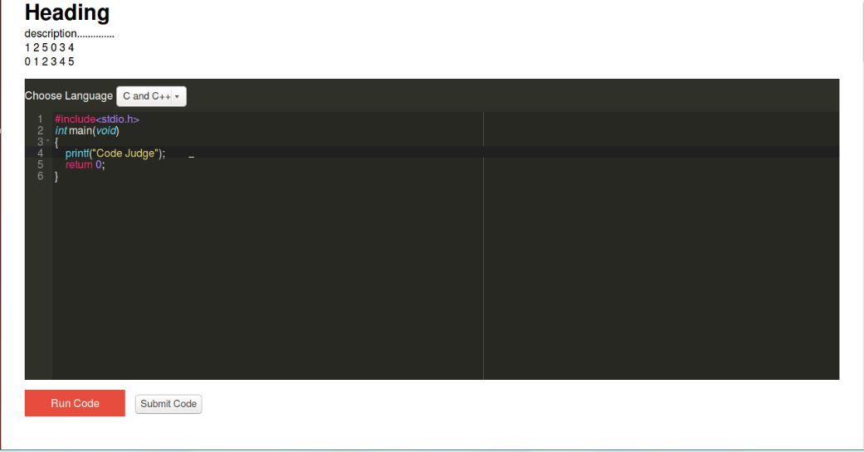
Editor Window

Slide 19
Test Case

Slide 20
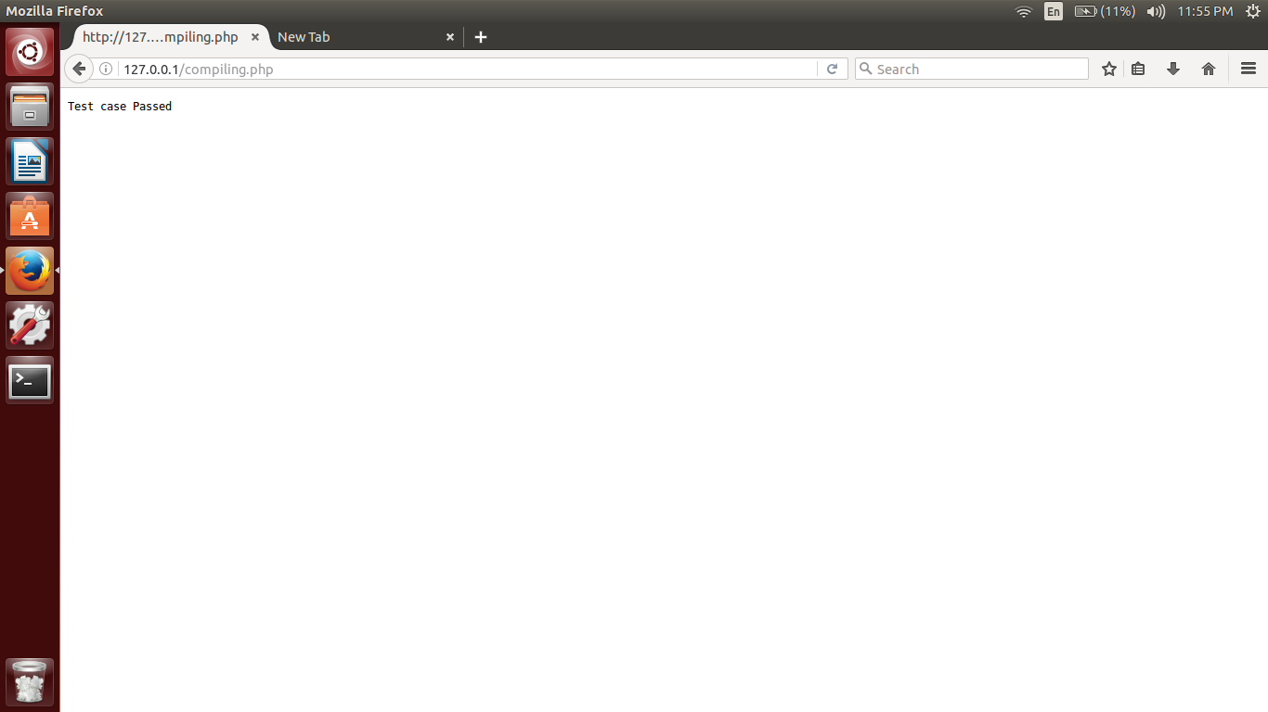
Test Case Passed

